Slide 1
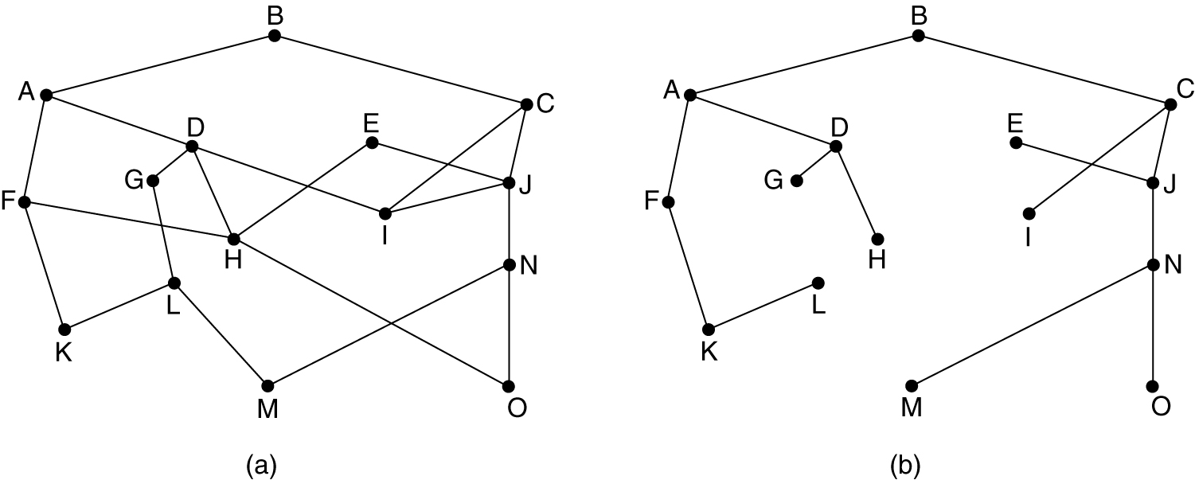
The Optimality Principle
(a) A subnet. (b) A sink tree for router B.

Slide 2
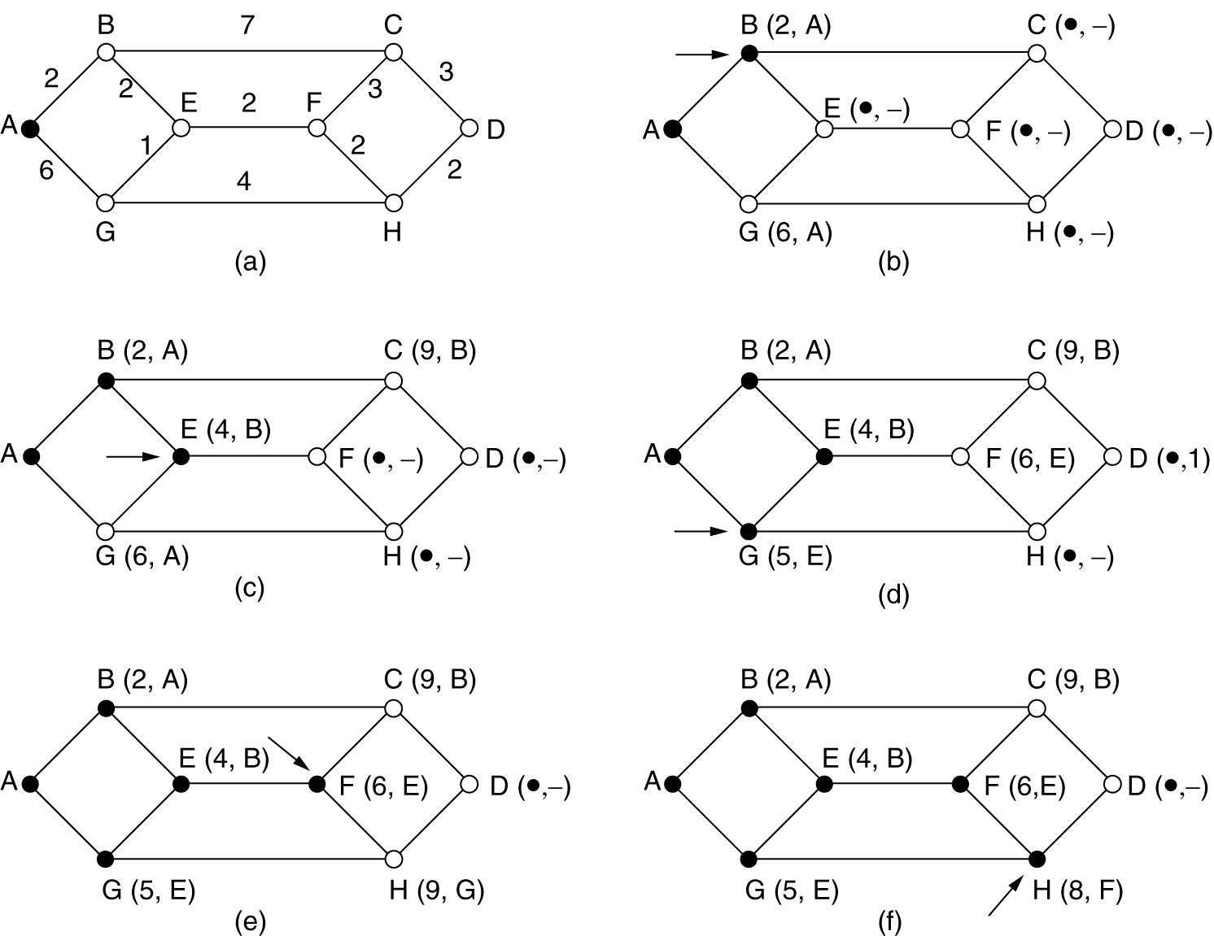
Shortest Path Routing
First 5 steps used in computing the shortest path from A to D
  Arrows indicate the working node
  (x,y) at each node represents x distance and y as previous node

Slide 3
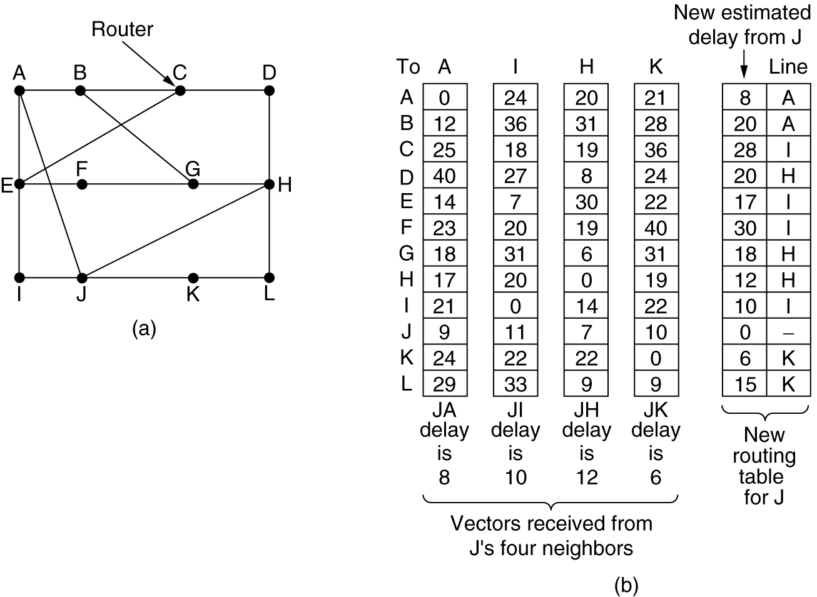
Distance Vector Routing
(a) A subnet. (b) Input from A, I, H, K, and the new
routing table for J.

Slide 4
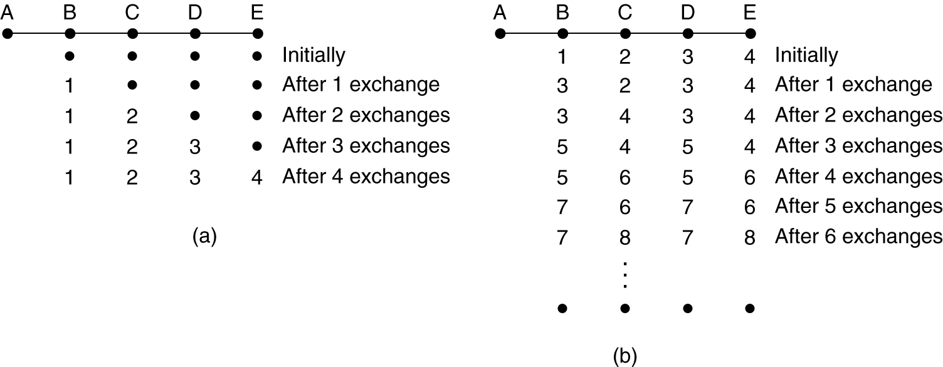
Distance Vector Routing
Count-to-infinity problem

Slide 5
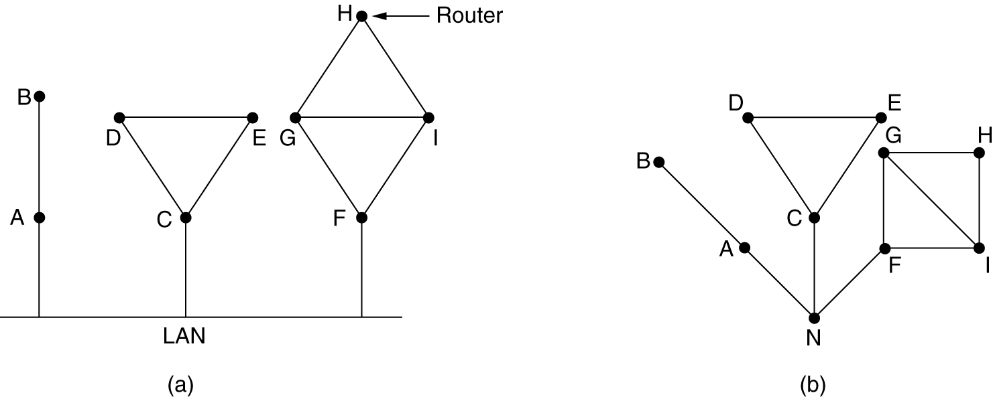
Neighbor Discovery
(a) Nine routers and a LAN. (b) A graph model of (a).
Node to represent LAN

Slide 6
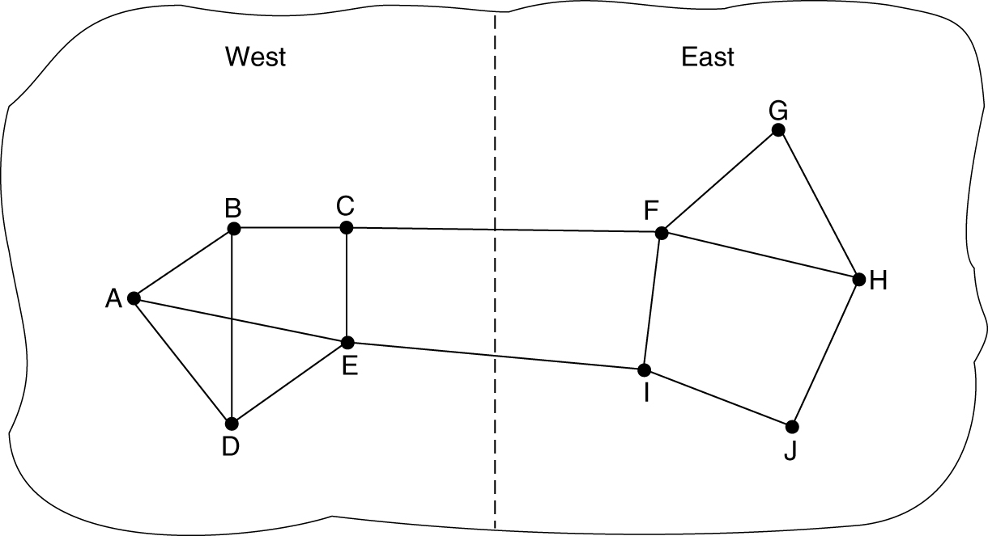
Line Cost Measurement
Subnet example with East and West parts connected by two lines

Slide 7
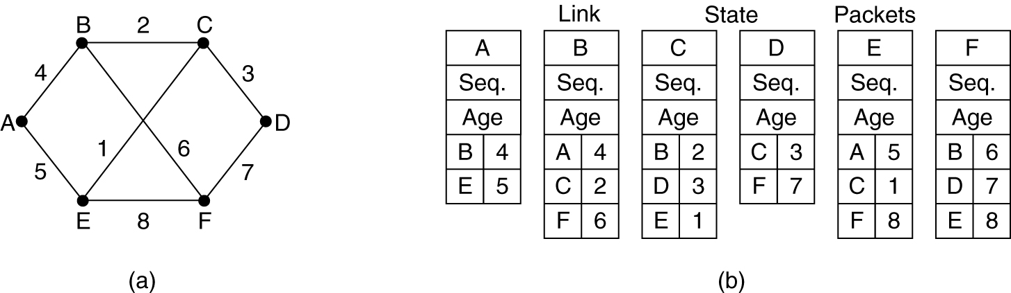
Building Link State Packets
(a) A subnet. (b) The link state packets for this subnet.

Slide 8
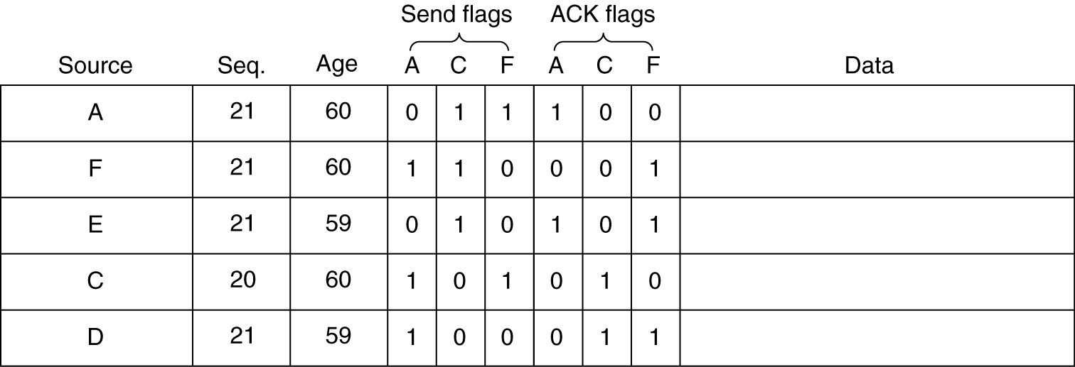
Link State Packet Distribution
The packet buffer for router B for below.

Slide 9
Discussion Question: Problem 5.7
Consider the network of Fig. 5-7, but ignore the weights on the lines. Suppose that it uses flooding as the routing algorithm. If a packet sent by A to D has a maximum hop count of 3, list all the routes it will take. Also tell how many hops worth bandwidth it consumes.

Slide 10
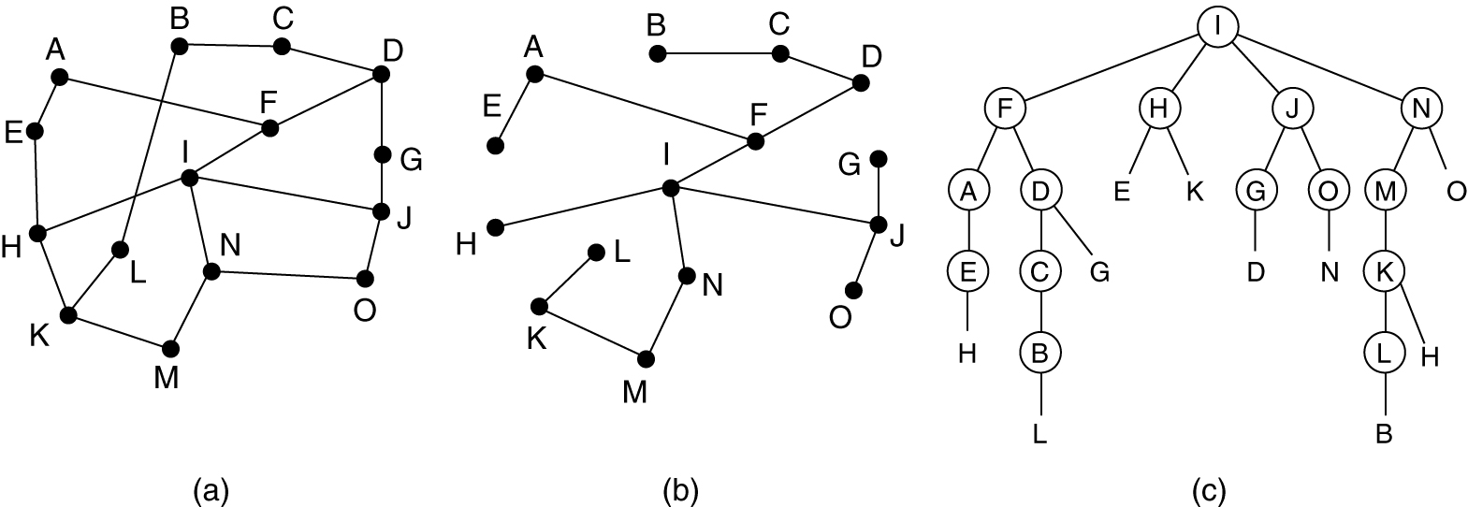
Broadcast Routing
Reverse path forwarding. (a) A subnet. (b) a Sink tree. (c) The tree built by reverse path forwarding.

Slide 11
Discussion Question: Problem 5.14
Looking at subnet of Fig. 5-6, how many packets are generated by a broadcast from B, using:
  Reverse path forwarding?
  The sink tree?
(a) A subnet. (b) A sink tree for router B.

Slide 12
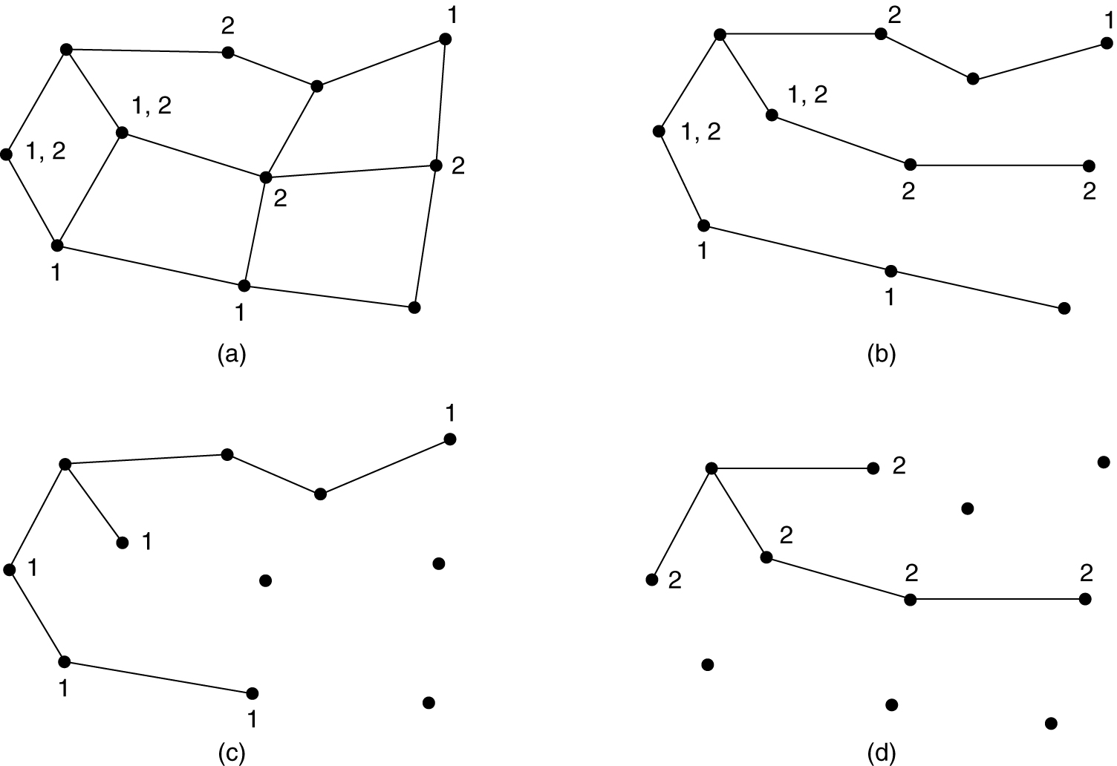
Multicast Routing
(a) A network. (b) A spanning tree for the leftmost router.
(c) A multicast tree for group 1. (d) A multicast tree for group 2.

